Slide 1
A DNA Algorithm for the Graph Coloring Problem
Wenbin Liu, Fengyue Zhang, and Jin Xu
J. Chem. Inf. Comput. Sci. 2002, 42, 1176-1178
Presenter: Chiao-Wei Chiu (邱喬偉)
Date: Jan. 4, 2007

Slide 2
Abstract
A DNA algorithm based on surfaces for the graph coloring problem is presented. First the whole combinatorial color assignments to the vertices of a graph are synthesized and immobilized on a surface; then a vertex is legally colored while those adjacent to it with illegal colors are deleted; and the cycle is repeated until finally the correct color assignments to the graph are reached. Compared with the other DNA algorithms, our algorithm is easy to implement and error-resistant.

Slide 3
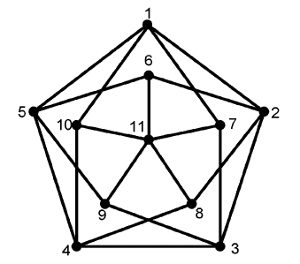
The Graph Coloring Problem
Given a graph G and an integer k, is there a way to color the vertices with k colors such that adjacent vertices are colored differently? Generally, there exist k^{n} (n is the total number of vertices in graph G) candidate solutions for this problem.
The specific graph concerned in this paper is shown in Figure 1. It is a typical four critical graph, and, based on graph theory, it cannot be legally colored with colors less than four.

Slide 4
Algorithm for the Graph Coloring Problem
Step 1: Assign k colors to each vertex of the graph G;
Step 2: Select the first legal color for vertex V_{i}(1 <= i <= n - 1) and delete other color assignments;
Step 3: Delete those vertices that both have the same color with vertex V_{i} and connected with it in parallel
Step 4: Repeat steps 2 and 3 until the last vertex V_{n} is reached; detect whether there exist legal colors for V_{n}. If the answer is yes, then output “YES”, otherwise output “NO”.

Slide 5
Encoding Scheme
In this paper we use four colors
B (blue), G (green), R (red), and Y (yellow)
Single strands in the form of
5’-C₆-T₁₅-V₁₂-CCCGGG-F₁₂-3’
are used to encode one possible coloring of each vertex in the graph.
T₁₅ is used to separate the hybridizing sequences from the surface
V₁₂-CCC and GGG-F₁₂ respectively encode vertex V_{i} and its colors.

Slide 6
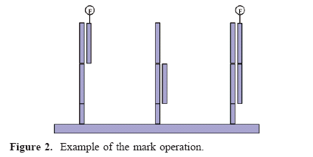

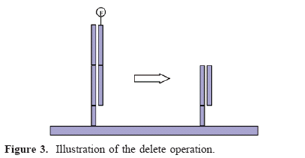
Surface Based Operations
Mark (complement rule)
  color
  vertex
Unmark (94°C by distilled water)
Scan (fluorescent images)
Delete
  unmarked : E coli.
  double strands:
    split at the middle position

Slide 7
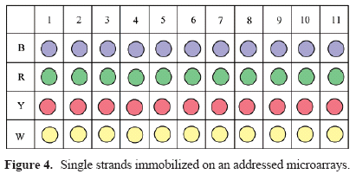
Implementation
Step1:
Each column on the surface is assigned to one vertex, while the four rows represent its four different colorings.
Step 2:
The first legal color for V_{i} is scanned
If there no legal colors, output “NO”
Unmark: reset the surface
Mark the first legal color
Mark V_{j} != V_{i}
Delete the other color of V_{i}
Step 3:
Unmark: reset the surface
Mark the first legal color
Mark V_{j} connected with V_{i}
Delete them
Step 4: repeat 2,3 until V_{n} reached.

Slide 8
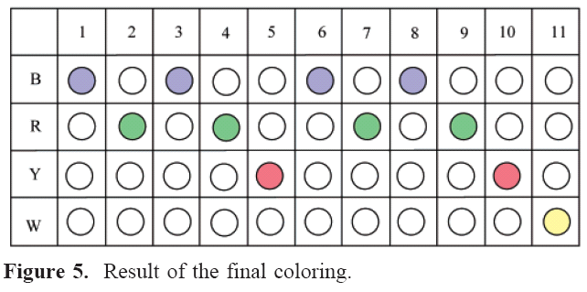
Result
If only three colors were used, then the last vertex 11 will have no legal color left.
If only two colors were used, then the computing process will terminate at loop 5.

Slide 9
Conclusion: Advantages
The length of DNA strands is only needed to increase the encoding of more vertices as the problem size increases.
Because only short DNA strands are needed in our algorithm, the computational process can be implemented in a reliable way.
As we arrange all the single strands in the microarrays, the final result is easily detected without using other additional techniques such as PCR and sequencing which are laborious and error prone.
The efficiency of our method can be seen from the time complexity of our algorithm O (n) (verses O (n²) in others).(?)

